Slide 1

An Intro to Nvidia Nsight Systems
Nov 14 2025

Slide 2
How does it work?
About
Nsight Systems is a system-wide performance analysis, we can capture activity across the CPU, GPU, and OS!
Uses low-overhead tracing/sampling to find bottlenecks – thus can’t exactly tell you why slowdowns are occurring, just where + when.
Optimization
If bottleneck is GPU-bound, we can use Nsight Compute to analyze specific kernels (not discussed here)
Otherwise, profile as normal.
https://docs.nvidia.com/nsight-systems/UserGuide/index.html , https://docs.nvidia.com/nsight-systems/AnalysisGuide/index.html
Data Collection
APIs
CUDA, kernel launches, etc.
OS
Thread states, CPU cores, etc.
GPU
SM utilization, tensor cores, memory throughput, etc.
CPU
Call stack, functions, etc.
NVTX
User-defined activity markers

Slide 3
Installation
Download from here: https://developer.nvidia.com/nsight-systems/get-started#reqs
Needs to be on both your workstation and personal device! (if you are using SSH)
Set execution privileges in the file via chmod +x NVIDIA_Nsight_Systems_Linux_*.run
Run ./NVIDIA_Nsight_Systems_Linux_*.run to make it available
Profiling
Flag | Description
-o, --output <name> | Filename for output.
-t, --trace <apis> | Select which APIs to trace (ex. cuda, nvtx, osrt, cudnn, mpi)
-y, --delay <s> | Delays start of data collection by s seconds.
-d, --duration <s> | Stops data collection after s seconds.
--capture-range <trigger> | Starts data collection only after a trigger is hit (ex. nvtx).
--stats <bool> | Run nsys automatically after collection finishes.
--export <type> | Export report automatically to another format (ex. sqlite, csv, etc.)
Post-run analysis (most common/easier to use)
Run nsys profile -o report julia script.jl
”report”: name of the output file, ”script”: name of the input file
During-run analysis (not discussed here)
Interactive CLI
Launch in terminal w/ manual control over what runs
Run nsys launch julia –project=.script.jl, nsys start/stop, etc.
Interactive GUI
Launch in program on remote and view locally as it runs
Run ssh -X user@server nsys-ui
Each method outputs a .nsys-rep file which we can analyze further…

Slide 4
Viewing Results
 | CLI Statistics | Expert System | Local GUI*
Command | nsys stats report.nsys-rep | nsys analyze report.nsys-rep | nsys-ui report.nsys-rep
Goal | Quick summary | Interpret results | Visual performance analysis
Output | API, kernel, memory operation, push/pop range, runtime API statistics | Problems identified and suggestions to fix them | Timeline of CPU, GPU, OS activity, analysis summary, diagnostics summary, CPU samples
How | Input .nsys-rep or .sqlite via command in terminal | Input .nsys-rep or .sqlite via command in terminal | Transfer .nsys-rep to local, then run command to open with GUI manually

Slide 5
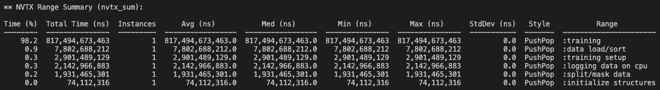
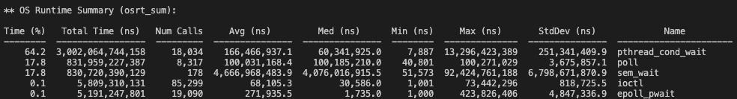
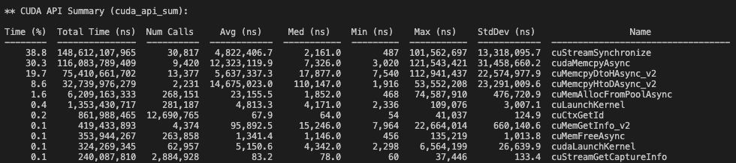
Analyzing Results - Summaries
CLI Statistics (nsys stats)
Total runtime sectioned by manually defined labels
Total runtime spent in OS calls
Wait/sleep
Wait to sync CPU with GPU
Total runtime spent in CUDA API calls (CPU to GPU)
Copy between CPU and GPU

Slide 6
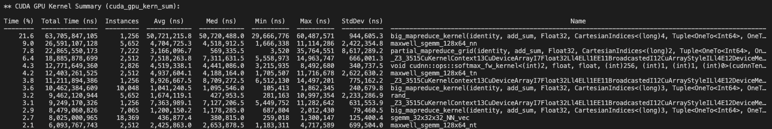
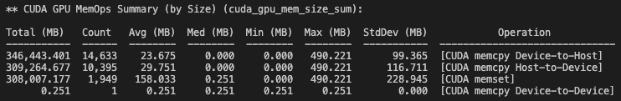
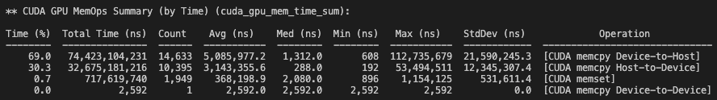
Analyzing Results - Summaries
CLI Statistics (nsys stats)
Map reduce operation
Total runtime spent on GPU kernels
Matrix multiplication
Softmax function!
Total size of data copied between CPU and GPU
GPU to CPU = device to host
CPU to GPU = host to device
300GB moved!
Total runtime spent copying data between CPU and GPU

Slide 7
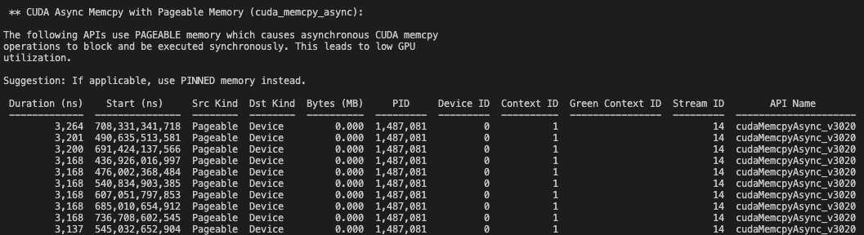
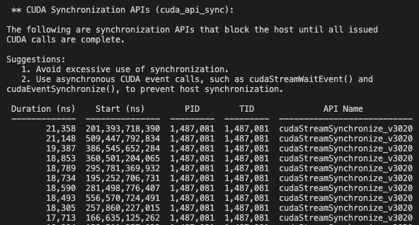
Analyzing Results - Flags
Expert System (nsys analyze)
Need to align the ”Start (ns)” timestamp with GUI results and NVTX ranges to actually see/fix where these are occurring.
Flags use of async copy calls from “pageable” memory
Flags where CPU code stops and waits for the GPU

Slide 8
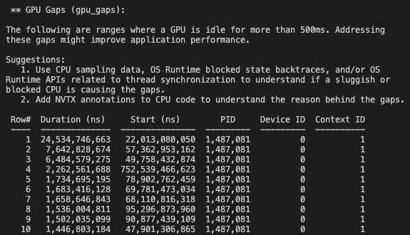
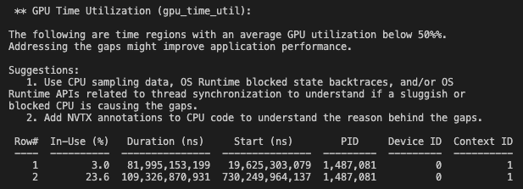
Analyzing Results - Flags
Expert System (nsys analyze)
Need to align the ”Start (ns)” timestamp with GUI results and NVTX ranges to actually see/fix where these are occurring.
Flags where GPU was found to be idle for >0.5s
Flags where GPU was sub-optimally utilized

Slide 9
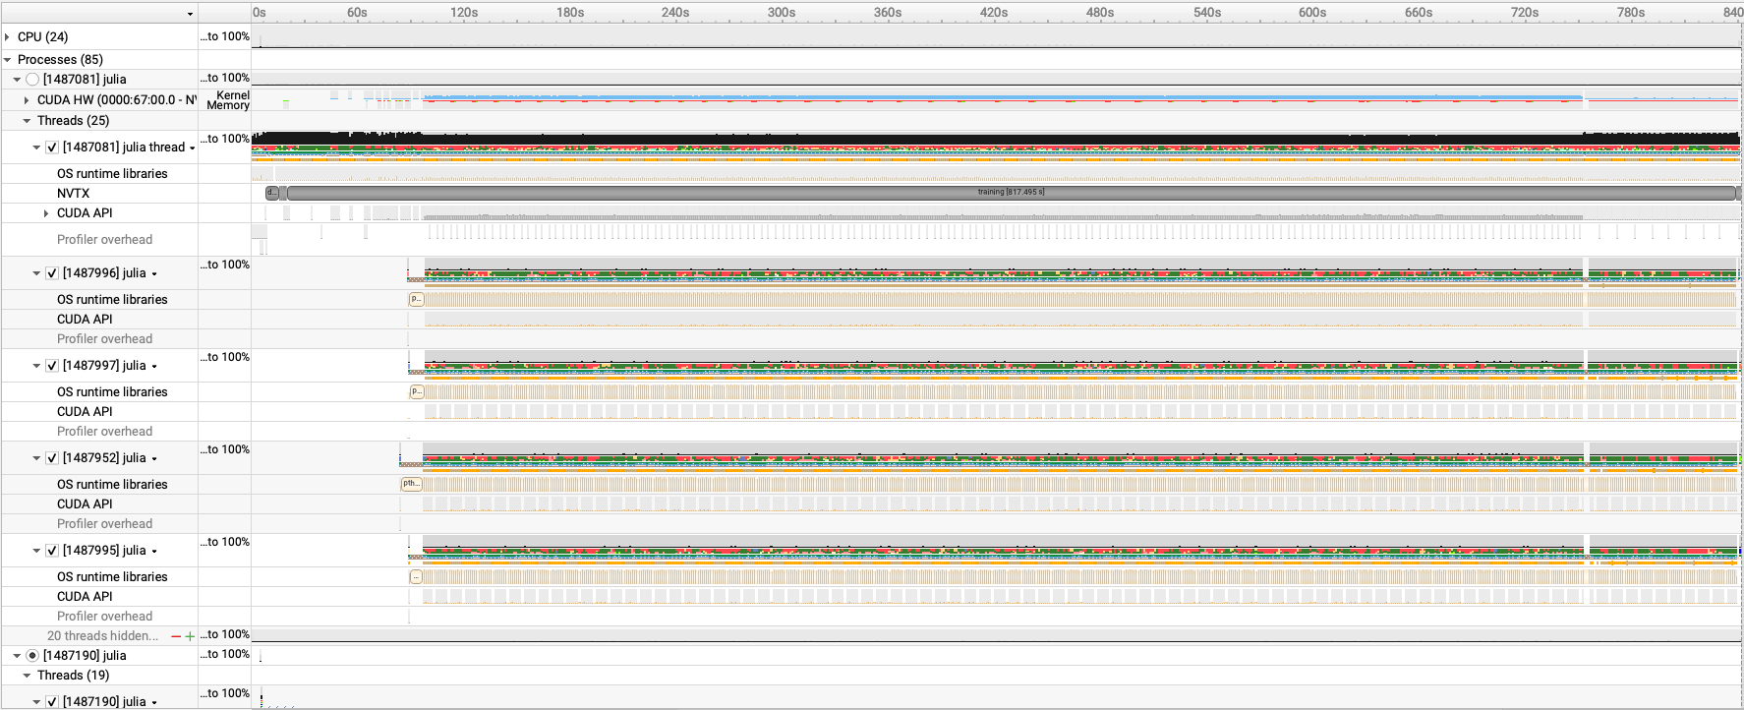
Analyzing Results - Timeline View
Local GUI (nsys-ui)

Slide 10
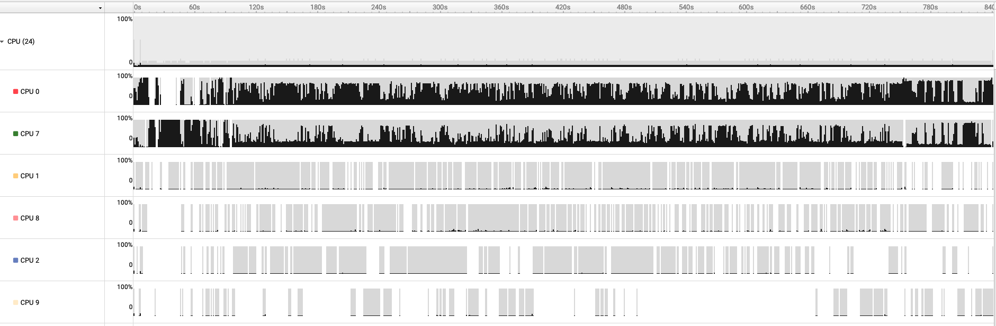
Analyzing Results - Timeline View (CPU)
Local GUI (nsys-ui)
Black: active CPU execution
Gray/white: Idle or context switching

Slide 11
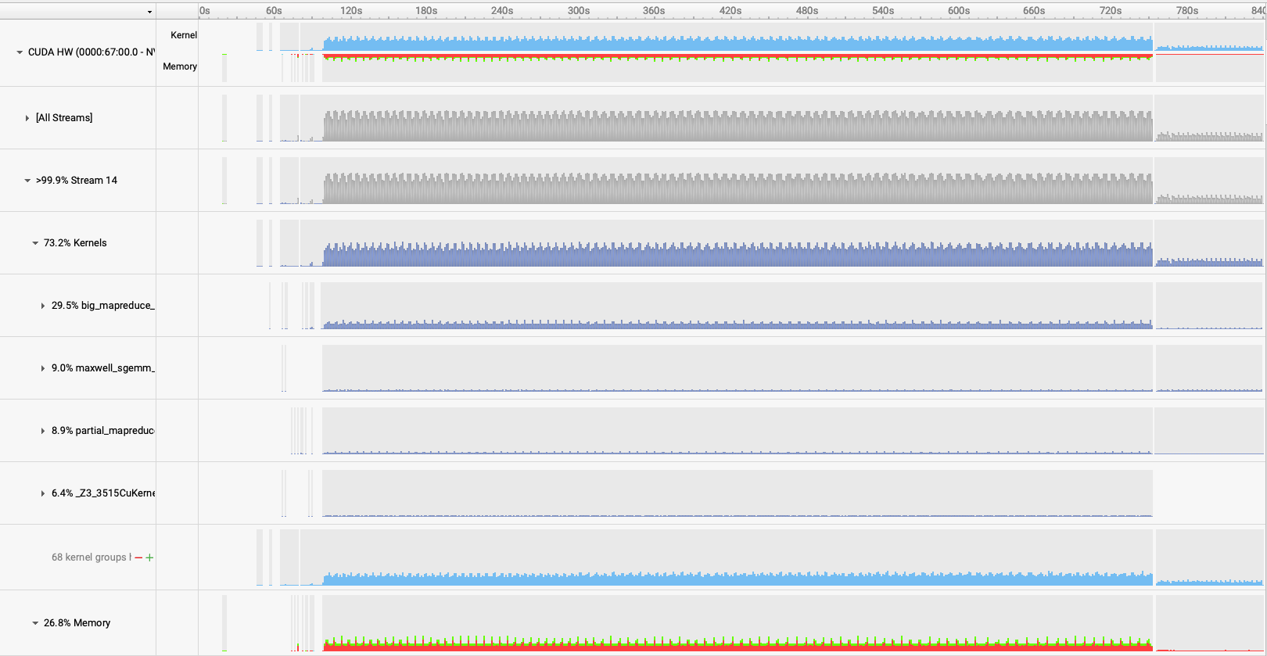
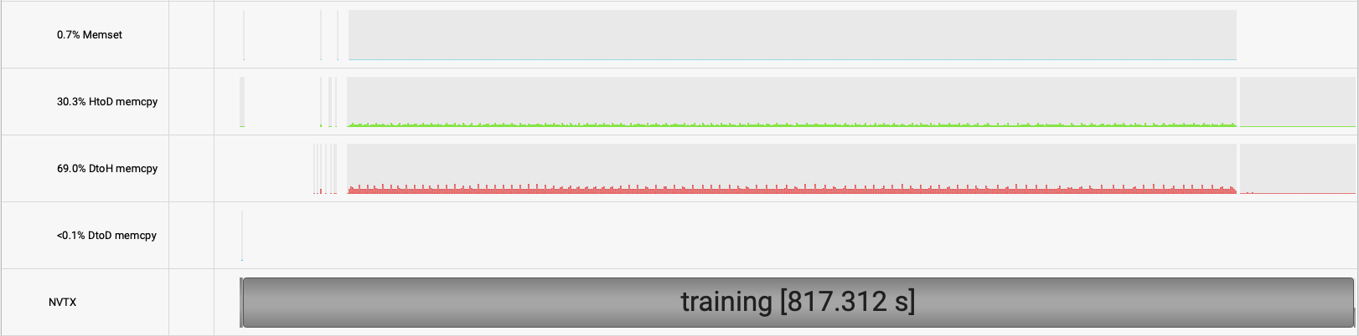
Analyzing Results - Timeline View (GPU)
Local GUI (nsys-ui)
Blue/purple: active kernels
White: idle GPU
Green: CPU to GPU
Red: GPU to CPU

Slide 12
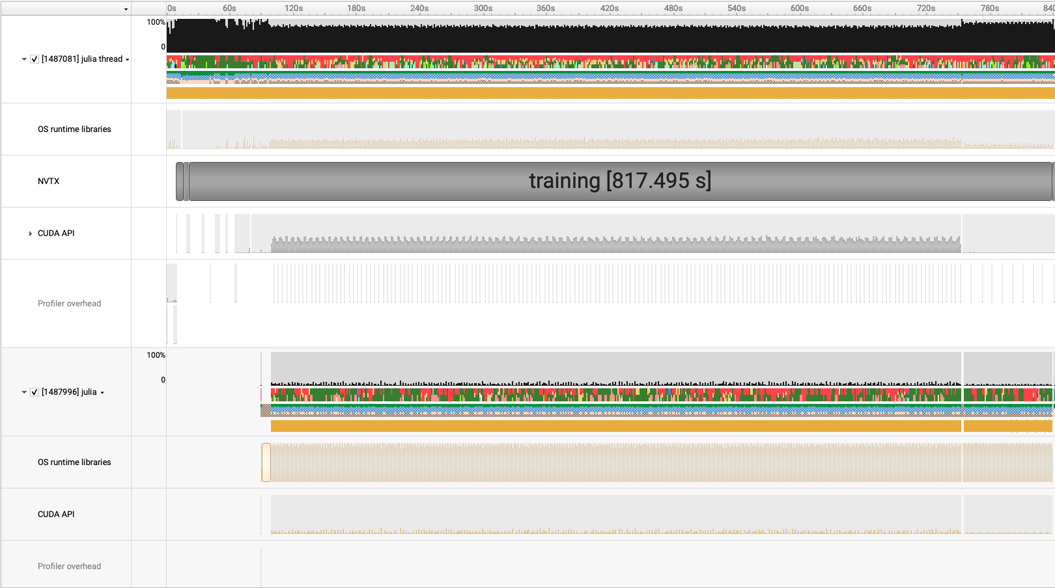
Analyzing Results - Timeline View (Threads)
Local GUI (nsys-ui)
Black: CPU utilization
Red/Orange: OS runtime libraries
Green: CUDA API call
Blue: CUDA driver
These two rows are just isolating the colors of the row above
Each spike is a call to OS
Each block is 1 call to a function in CUDA API

Slide 13
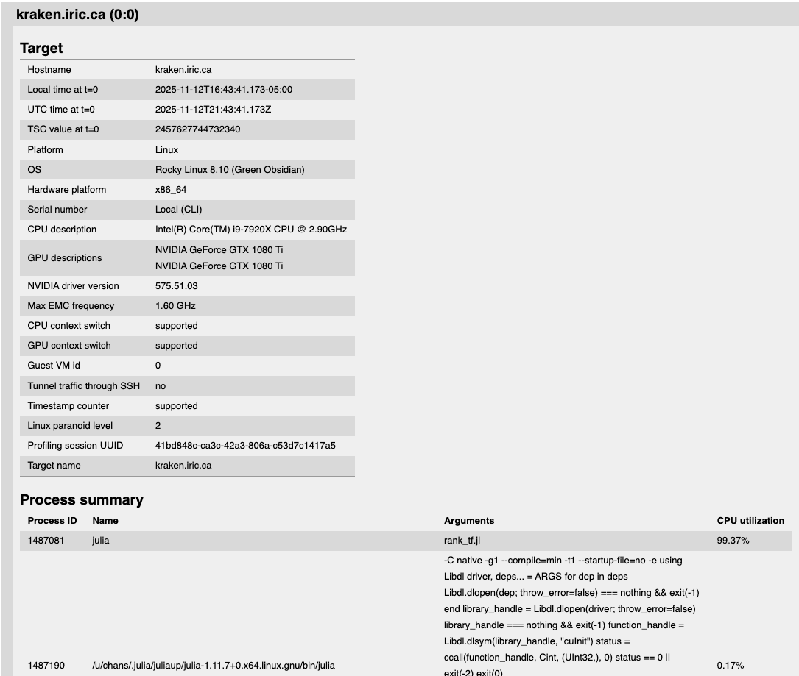
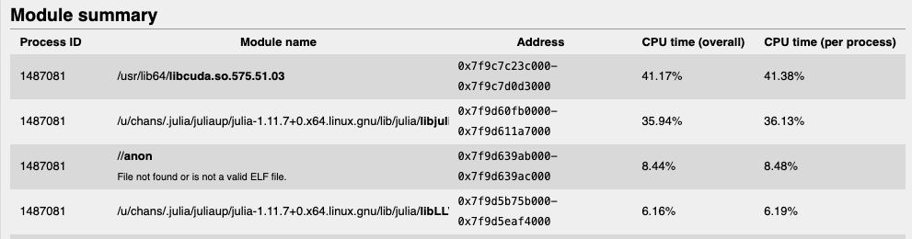
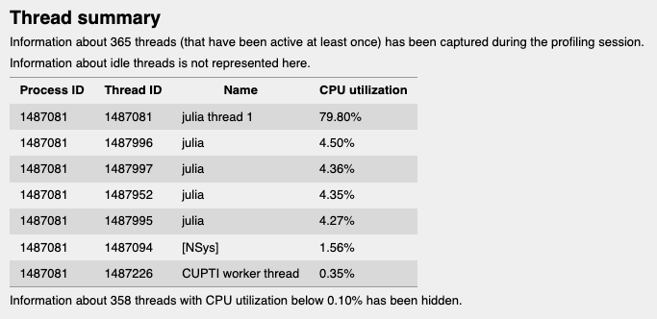
Analyzing Results - Analysis Summary
Local GUI (nsys-ui)
Summary of system, application, hardware, processes, etc.

Slide 14
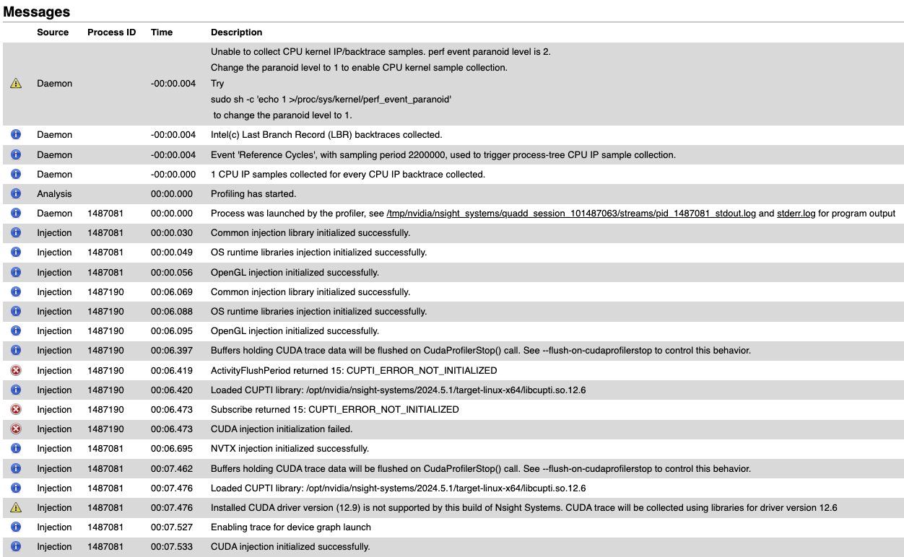
Analyzing Results - Diagnostics Summary
Local GUI (nsys-ui)
None of these are critical to fix ☺
If we want to debug Nsight itself, we can see warnings, etc. here

Slide 15
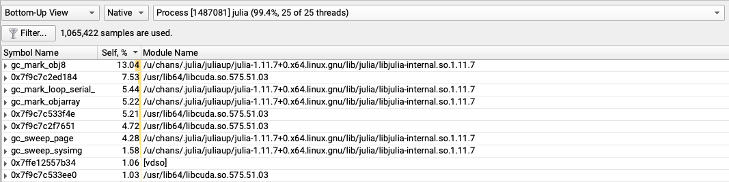
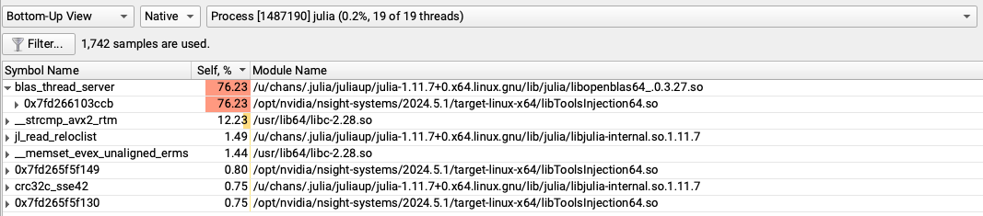
Analyzing Results – Bottom-Up View
Local GUI (nsys-ui)
Garbage collection
CPU linear algebra library
Shows what the CPU cores are doing!

Slide 16
Demo :D

